Slide 1
Building multi-agent experiences for the enterprise world
Matteo Pagani
Cloud Solution Architect @ Microsoft
ABS Tech Strategy

Slide 2
What is a multi-agent system?
A multiagent system is a group of autonomous AI agents working together to solve complex tasks.
AGENTS
INTERACTIONS
Individual parts of the system.
Each agent has its own abilities, knowledge, and goals. Agents can be language models, tools.​..
Agents interact with each other with various methods, such as talking to each other, working together, or competing.​
Notes:
A Multi-Agent System (MAS) is a type of computer system where multiple independent entities, called agents, work together or compete in a shared environment to reach their goals. Unlike single-agent systems, where one agent handles tasks alone, MAS involves several agents interacting with each other and their surroundings.
"Each agent is a specialized team member with its own abilities, knowledge, and goals. Think language models, data analysis tools, or specialized processors. They're autonomous - they make their own decisions within their role."
"The magic happens when agents communicate and collaborate. They share information, divide tasks based on strengths, and coordinate efforts. Sometimes they even compete to find the best solution."
"Like customer service - one agent understands questions, another searches databases, a third crafts responses. Together, they're much more effective than working alone."

Slide 3

Why not just one LLM?
FLEXIBILITY
SCALABILITY
SPECIALIZATION
PERFORMANCE
Multiagent systems can adjust to varying environments by adding, removing or adapting agents.
A single LLM can only "remember" a limited amount of input (limited context window)
Different agents can be trained or prompted to excel at specific tasks
Multiagent frameworks tend to outperform singular agents

Slide 4
Challenges of multi-agent systems
CONTROLLABILITY
COORDINATION COMPLEXITY
UNPREDICTABLE BEHAVIOR
Difficulty having control on the behavior of the system
Preventing conflicts and ensuring coherent collective behavior
Detecting issues is complicated due to the independency of agents
ERROR PROPAGATION
TASK TERMINATION
COST
Error from a single LLM agent can propagate through the network
Calling too many LLM inferences can become very expensive
Avoiding infinite loops in long task can be challenging.

Slide 5
What about enterprise scenarios?
ENTERPRISE-READY
INTEGRATION
EVALS
Enterprise-grade support
Easy access from enterprise tools like Microsoft 365
Evaluating the quality of responses is crucial
COST TRACKING
RESPONSIBLE AI
TAILORED FOR THE ORGANIZATION
Track the costing of agents
Making sure that agents are compliant with company policies and rules
Agents need access to organizational data

Slide 6
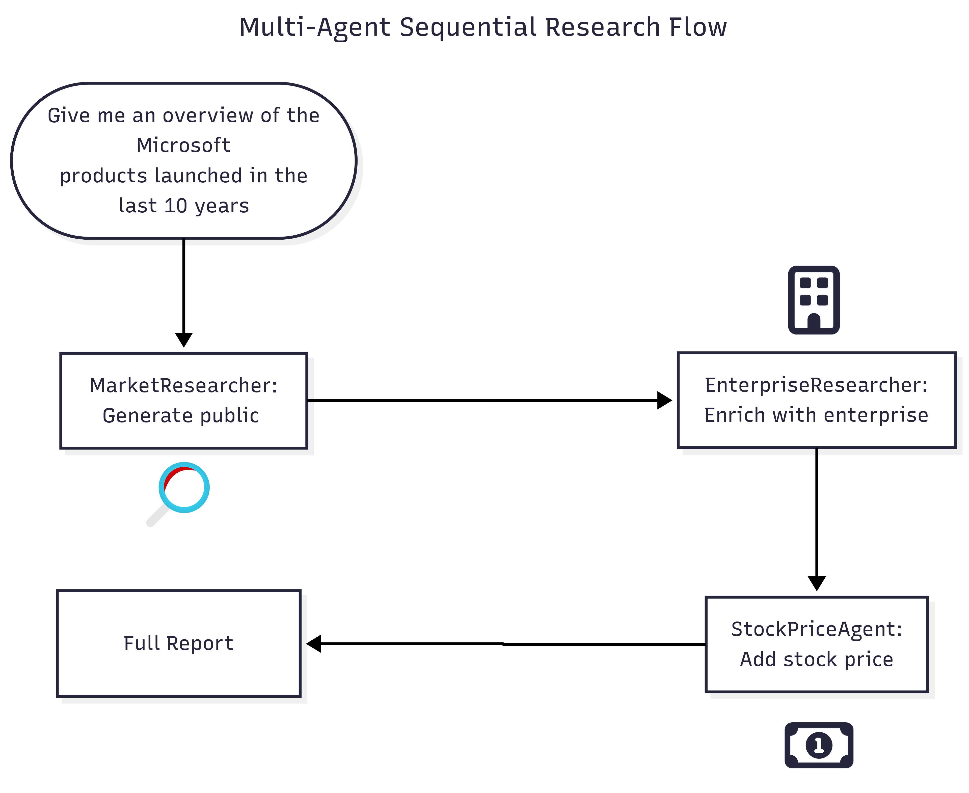
The scenario

Slide 7



Getting help from technology!
Step 1
Let’s build an agent and setup the orchestration
Step 2
Let’s host an agent running in the cloud
Azure AI Foundry
Step 3
Let’s add an agent which uses organizational data in a secure way
Copilot APIs

Slide 8


Getting help from technology!
Step 4
Let’s integrate the agent into
the enterprise ecosystem
Microsoft 365 Agents SDK
Step 5
Let’s build observability and monitoring
.NET Aspire

Slide 9
Microsoft Agent Framework
A new open-source agentic framework by Microsoft that combines the best of Semantic Kernel and AutoGen: enterprise-ready and open to innovation
Available for .NET and Python
Cloud and AI agnostic
Built on 4 pillars:
Support for MCP
Support for A2A
OpenAPI
Cloud-agnostic runtime

Slide 10
 | Semantic Kernel | AutoGen | Microsoft Agent Framework
Focus | Stable SDK with enterprise connectors, workflows, and observability | Experimental multi-agent orchestration from research | Unified SDK combining innovation + enterprise readiness
Interop | Plugins, connectors, and support for MCP, A2A, OpenAPI | Tool integration supported; lacks standardized cross-runtime protocols | Built-in connectors, MCP + A2A + OpenAPI
Memory | Multiple vector store connectors and memory store abstraction (e.g. Elasticsearch, MongoDB) | Support for in-memory / buffer history + external vector store memory options (ChromaDB, Mem0, etc) | Pluggable memory across stores (first-party and third-party), persistent & adaptive memory stored with retrieval, hybrid appraoches
Orchestration | Deterministic + dynamic orchestration (Agent Framework, Process Framework) | Dynamic LLM orchestration (debate, reflection, facilitator/worker, group chat) | Deterministic + dynamic orchestration (Agent Orchestration, Workflow Orchestration)
Enterprise readiness | Telemetry, observability, compliance hooks | Minimal | Observability, approvals, CI/CD, long-running durability, hydration

Slide 11
Step 1
Microsoft Agent Framework
Let’s build an agent

Slide 12
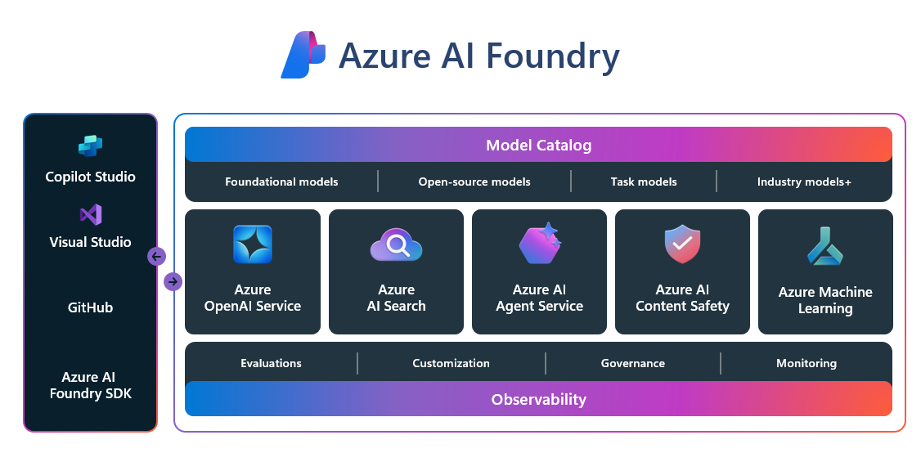
Azure AI Foundry

Slide 13
Step 2
Microsoft Agent Framework
Azure AI Foundry SDK
Let’s add a cloud agent

Slide 14
Copilot APIs
Safely, Securely & Efficiently
Retrieval API
/copilot/retrieval
Chat API
/copilot/chat
Interactions Export API
/copilot/getAllEnterpriseInteractions
Meeting Insights API
/copilot/aiInsights
Copilot APIs

Slide 15
REST API Request
Semantic search across enterprise data
Application gets list of summaries generated for a meeting:
GET – https://graph.microsoft.com/beta/copilot/retrieval
HTTP/1.1 200 OK
Content-type: application/json
{
"queryString": "How do I setup Microsoft VPN?",
"filterExpression":
"path:\"https://microsoft.sharepoint.com/sites/Hrweb\"
OR path:\"https://microsoft.sharepoint.com/sites/globalsecurity\"",
"resourceMetadata": [
"author",
"title"
],
"maximumNumberOfResults": 4
}
Scenario: Contoso applications wants to fetch all documents that are relevant for a query on behalf of User A

Slide 16
REST API Response
{
"webUrl": "https://sharepoint.contoso.com/.../document1.docx",
"extracts": [
{
"text": "MSFT-AzVPN is our VPN solution for remote connectivity on Windows 11 and Windows 10 devices. Connect to MSFT-AzVPN from the Windows start menu..."
}
],
"resourceType": "driveItem",
"resourceMetadata": {
"author": “John Doe",
"title": "Instructions to set up MSFT-AzVPN"
},
"sensitivityLabel": {
"sensitivityLabelId": "f71f1f74-bf1f-4e6b-b266-c777ea76e2s8",
"displayName": "Confidential\\Any User (No Protection)",
"toolTip": "Data is classified as Confidential…",
…
}
}
Document URL
Text chunk from document
Document type
Requested document metadata
Sensitivity label metadata

Slide 17
Step 3
Microsoft Agent Framework
Copilot APIs
Let’s add an enterprise search agent

Slide 18



Microsoft 365 Agents SDK
Your agent, your way for the most advanced needs
Build on your terms with Azure AI or your choice
Seamlessly integrate into and from
Copilot Studio
Publish across multiple channels

Slide 19
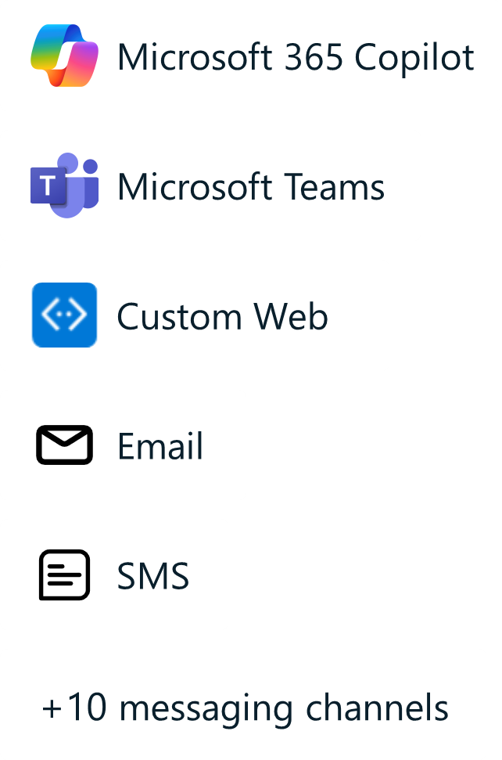

Inside an agent built with the Microsoft 365 Agents SDK
Your own custom engine agent
M365 Agents SDK
+
Customer Code
M365 Agents SDK
+
Customer Code
Semantic Kernel
Langchain
Azure AI Foundry
Orchestration
Other AI Services
Copilot Studio
Copilot Studio
AI services
User asks a question and sends it to the client
User sees a response in the client
Orchestration
Dataverse & Plugins/Actions

Slide 20
Step 4
Microsoft 365 Agents SDK
Integrate the agent in the enterprise ecosystem

Slide 21
.NET Aspire
.NET Aspire is a stack for building resilient, observable, and configurable cloud-native applications with .NET and other frameworks
.NET Aspire includes a curated set of components enhanced for cloud-native fundamentals including Telemetry, Resilience, Configuration, Health Checks, and Composition
.NET Aspire makes it easy to discover, acquire, and configure essential dependencies for cloud-native applications on day 1 and day 100

Slide 22
Step 5
.NET Aspire
Let’s add observability and tracing

Slide 23
What about enterprise scenarios?
ENTERPRISE-READY
INTEGRATION
EVALS
Easy access from enterprise tools like Microsoft 365
Evaluating the quality of responses is crucial
Enterprise-grade support
COST TRACKING
RESPONSIBLE AI
TAILORED FOR THE ORGANIZATION
Track the costing of agents
Making sure that agents are compliant with company policies and rules
Agents need access to organizational data

Slide 24
Resources

Slide 25
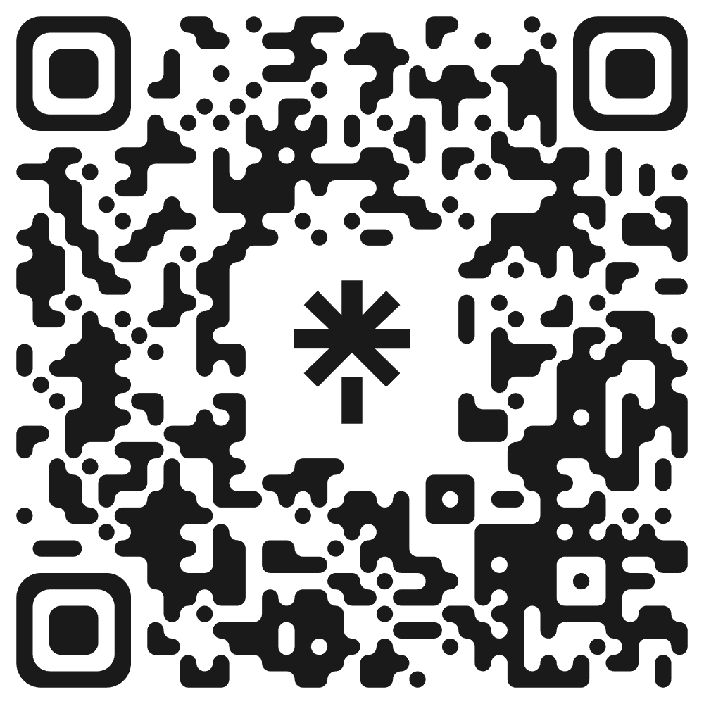
Let’s get in touch!

Slide 26

Don't forget to rate the talk!

